Slide 1
The Dawn of Benchmarking
John Makhoul
BBN Technologies
john.makhoul@raytheon.com
Benchmarking: Past, Present, and Future
5 August 2021
This document does not contain technology or technical data controlled under either the U.S. International Traffic in Arms Regulations or the U.S. Export Administration Regulation.

Slide 2
1987
A watershed year in the history of benchmarking in Human Language Technology (HLT)
Initially in Automatic Speech Recognition (ASR)
There was always a desire to benchmark
Benchmarking took off with the confluence of several factors
Insistence on benchmarking
Development of common corpora
Defined metrics
Use of trainable systems
Wide participation
Resulting acceleration in technology development
A positive feedback loop

Slide 3
Generations of Automatic Speech Recognition (ASR)
1960 1970 1980 1990 2000 2010 2020
1965
1G
1987
Heuristic approaches
(Knowledge-based; Rule-based)
1968
2G
1980
Pattern matching
(LPC, FFT, DTW)
1975
3G
Model-based statistical framework
(HMM, n-gram, neural net)
2010
4G
Deep learning
(Adapted from Furui)

Slide 4
Heuristic Approaches
Knowledge-based; rule-based
Historical: inspired by speech production and perception
The spectrogram as a tool, and the basilar membrane as a filter bank
Learning to read spectrograms was fun and seductive
Phonetic Distinctive Features (high/low, front/back): people wanted to find invariant acoustic correlates
1983 symposium in honor of Ken Stevens’ 60th birthday
“Invariance and Variability of Speech Processes”
Published in 1986, Perkell & Klatt, Eds.
If you could just find those invariant acoustic features, the problem is solved!
“Ignorance Modeling,” commentary by Makhoul & Schwartz

Slide 5
Reactions to difficulty of ASR
John Pierce, AT&T Bell Labs, 1969
ARPA Study Group, 1970

Slide 6
“Whither Speech Recognition”
John Pierce (AT&T Bell Labs), JASA, 1969
Scathing diatribe against people working in ASR
“… performance will continue to be limited unless the recognizing device can understand what is being said with something of the facility of a native speaker”
Pierce stopped all work in ASR at AT&T Bell Labs
Work was continued a decade later by Jim Flanagan

Slide 7
ARPA Environment
ARPANET: Built by BBN, demonstrated a 4-node network in 1969
Precursor to Internet
Introduction of email, 1971
Using ARPANET to transmit voice
Network Speech Compression program: 1972-1982
Led to Voice over IP (VoIP)
Desire by ARPA to use human language, especially voice, to communicate with computers

Slide 8
ARPA Study – 1970
What is standing in the way of advances in speech recognition?
Committee: AI, NLP, and speech people – Newell (Chair), Barnett, Forgie, Green, Klatt, Licklider, Munson, Reddy, Woods
Report published in 1971: “Speech Understanding Systems: Final Report of a Study Group”
Assertion: “A speech recognition system will have to employ information from all levels – from the acoustic to the semantic – to effect recognition.”
Conclusions
We need to use “understanding” to help the speech recognition
Acceleration of progress will depend, in part, on “the availability of high grade public data”
Recommendation: Fund a 5-year Speech Understanding Research (SUR) program

Slide 9
ARPA SUR Program: 1971-1976
Participants: BBN, CMU, SDC/SRI
ASR: 1000-word vocabulary, continuous speech recognition
Most used “knowledge-based” (KB) methods
Exception: Jim Baker’s Dragon system at CMU used “HMMs”. However, advantages of this approach were lost on most people.
Only the very simplest tasks (small branching ratio) could be done in a reasonable amount of time
ARPA Director Heilmeier in 1976 stopped all work in this area
“Speech Understanding” became a “dirty word” at ARPA

Slide 10
Statistical Modeling Approach
Jelinek & group at IBM – 1975
Information-theoretic approach
Hence terms such as “decoder”, “perplexity”
Eventually settled on
n-gram language model for words
HMM acoustic model for phones

Slide 11
Hidden Markov Models
Probabilistic functions of a Markov chain
Institute for Defense Analyses (IDA) in Princeton, NJ
Baum, Petrie, Welch & colleagues – Late 1960s
IBM worked on similar models in the 1970s
In the 1970s, these models were used at IDA and IBM, plus Jim Baker, who had interned at IDA
7 October 1980: Workshop held by IDA on HMMs
About 40 invitees, from AT&T, BBN, CMU, IBM, etc.

Slide 12
The “Blue Book” – 1980
21 cm x 14 cm
Edited by Ferguson; chapters by others from IDA
First use of the term Hidden Markov Model (HMM)
Basic formulations, E-M algorithm, etc.
Formed basis for tutorial papers by Rabiner and Juang (1986, 1989)

Slide 13
1981 SCAMP
Summer Conference on Applied Mathematical Problems, Williamstown, MA
HMMs were featured in detail
Work on HMMs had started in earnest at AT&T, then at BBN

Slide 14
DARPA Strategic Computing Program - 1984
CMU won the main contract using a “knowledge-based” (KB) approach – Led by Raj Reddy
Spectrogram reading experiment by Ron Cole at CMU with Victor Zue from MIT as the expert spectrogram reader
Use expert knowledge to emulate what Victor Zue does
“Statistical approaches incapable of modeling fine phonetic distinctions”
A few small contracts were given to others, including BBN, with the objective of helping CMU
BBN’s proposal was based on HMMs
We decided to build a complete system based on HMMs
February 1986: First result that gave a hint of the power of HMMs, but no common evaluation
Semi-annual Speech Recognition Workshops
Published proceedings once each year starting in Feb. 1986

Slide 15
July 1986
DARPA Site Visit to BBN
Demo at BBN demonstrating the ability of HMMs to model phonetic distinctions
Allen Sears (DARPA PM), David Pallett (NIST), Ned Neuberg (DoD)
The system was named “Byblos” after the old Phoenician town where the first phonetic writing was found

Slide 16
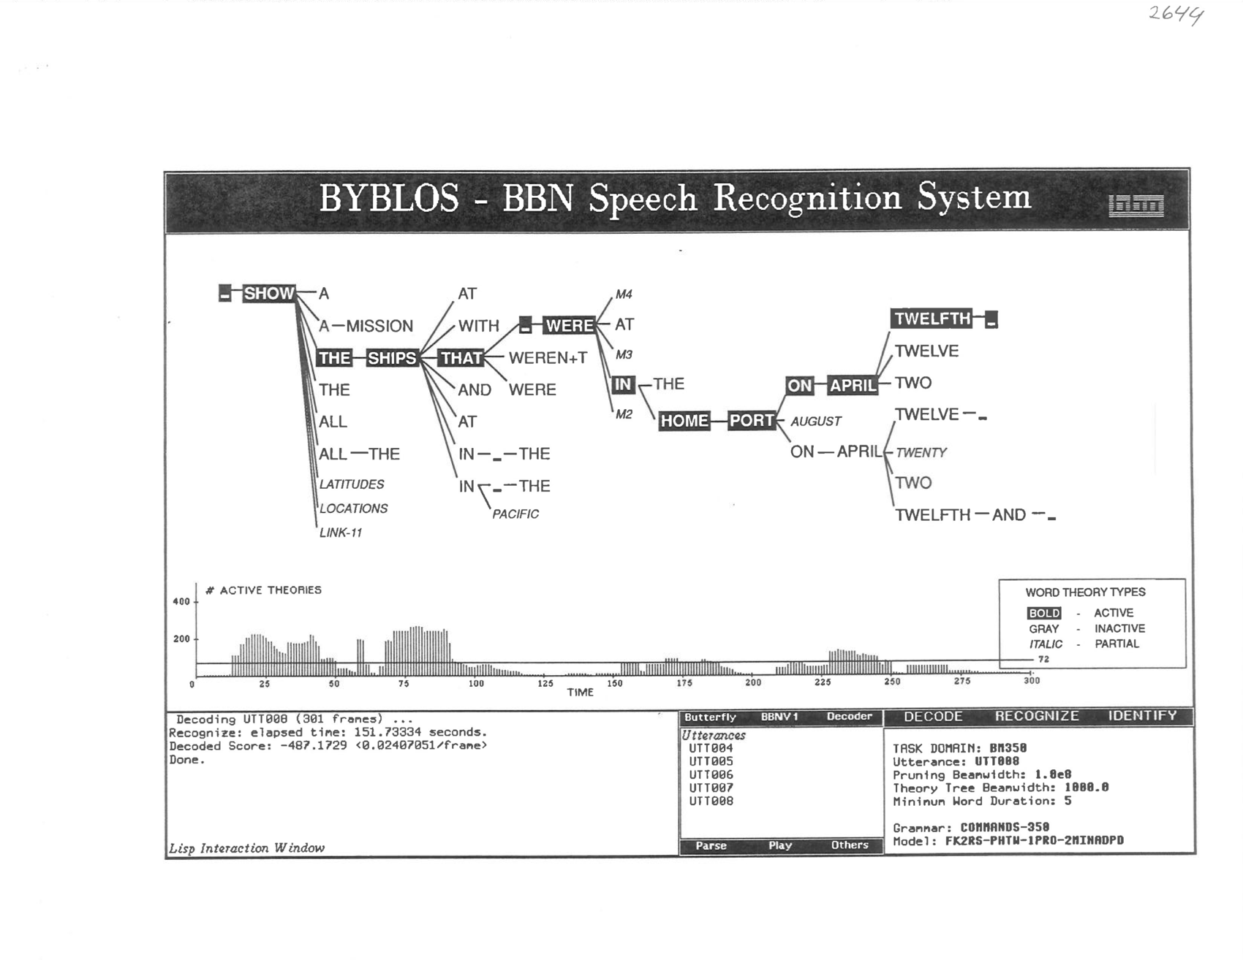

Slide 17
Ned Neuberg
Speech scientist
After the demo in 1986: “This was the first time I could say that, if you poured money into speech recognition research, it would be well worth it.”

Slide 18
Planning for Common Evaluations
Insisted upon by Allen Sears, DARPA Program Manager
Throughout 1986, coordinated by NIST
Collection of common corpora
Benchmark test procedures
Choice of training and test sets
Metric
All sites were consulted

Slide 19
Common Corpora 1986
DARPA Speech Recognition Research Database
TIMIT: TI, MIT, SRI, NBS (NIST)
10 phonetically rich sentences read by 630 speakers
For acoustic-phonetic research
DARPA Task Domain Speech Recognition Database
For testing speech recognition systems
Designed by NIST, BBN, CMU, SRI; recorded at TI
Resource Management Corpus, >1000 sentences
Recordings for speaker-dependent and speaker-independent work

Slide 20
Metrics (1986)
Initially, only “percent words correct” was required
No criterion for word beginning or ending times
Reporting substitutions, deletions, & insertions was optional

Slide 21
First Common Evaluation: March 1987
Only two teams participated: CMU, BBN
Knowledge-based vs. trainable system (HMM)
Resource Management Corpus
Clearly better performance by HMM system
HMM system had the following advantages
Automatically trainable
Does not require expert knowledge, only annotated data
Much simpler to build
New techniques easily transferrable to others
Claim that statistical methods cannot model phonetic distinctions was no longer viable

Slide 22
But, …
Perhaps knowledge-based methods were better at locating word boundaries
Another test was held in 1987
Word boundaries in test data were hand labelled by human experts
Here again, HMM system was better at locating word boundaries
By early 1988, CMU had shifted all work to HMMs

Slide 23
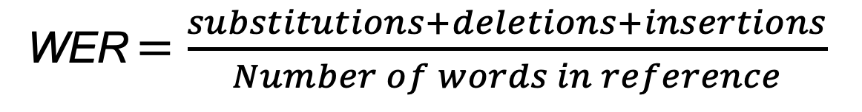
Final Metric
The community settled on Word Error Rate as the primary metric for speech recognition
Focus on error rate instead of accuracy
WER $=\frac{substitutions+deletions+insertions}{Number of words in reference}$

Slide 24
Other DARPA Programs
A series of DARPA programs followed
Spoken Language Systems (SLS) program, other NLP programs, and neural nets
Feb 1989: Speech and Natural Language Workshop
Started by Charles Wayne
Emphasis on common evaluations
Annual with published proceedings
120 people from 17 organizations in attendance, including IBM & AT&T, who were not funded by DARPA
1990: ATIS (Air Travel Information System)
1991: Attendance from Europe; seed funding and planning for the Linguistic Data Consortium (LDC), formalized in 1992
Sept 1992: Last Resource Management evaluation
Participation by Cambridge University and LIMSI (France)
Other corpora and evaluations followed, with greater participation

Slide 25
Result
Success of
Metrics-based evaluations
Common corpora
Automatically trainable systems
Acceleration of progress in ASR worldwide
Advances in computing speed and storage
Search strategies
Paradigm spread to other fields within and outside DARPA
Defining WER was easy; other metrics had to be developed for more challenging tasks
MT and other NLP tasks

Slide 26
A Plea in Corpus Creation
For every annotated corpus
Measure inter-annotator agreement on a small sample of the data
Publish the information along with the corpus
Inter-annotator agreement effectively places an upper limit on the accuracy of models and algorithms
Performance is gated by inter-annotator agreement

Slide 27
Postscript
Original assumption around 1970 that we needed more than acoustic information to perform good ASR was correct
But, what was thought of as “speech knowledge” was largely illusory with respect to its use in ASR
It turned out that all we needed was a good statistical language model to capture higher-level information
Original dream of having computer researchers communicate with their machines via voice did not materialize
But, people all over the world, are using apps like Siri and Alexa on a daily basis to access information and accomplish simple tasks via voice
How to capture and use sophisticated higher-level information, like semantics, continues to represent our holy grail

Slide 28
Thank You!

Slide 29
References (1)
R. Jakobson, G. Fant, & M. Hale, Preliminaries to Speech Analysis: The Distinctive Features and Their Correlates, MIT Press, 1951, 1961.
N. Chomsky & M. Hale, The Sound Pattern of English, Harper & Row, 1968.
J.S. Perkell & D.H. Klatt, Eds., Invariance and Variability in Speech Processes, Lawrence Erlbaum Associates Publishers, 1986. Includes comments by Makhoul & Schwartz, “Ignorance Modeling,” pp. 344-345.
J.R. Pierce, “Whither Speech Recognition?” J. Acoust. Soc. America, vol. 46, Oct. 1969.
A. Newell et al., Speech Understanding Systems: Final Report of a Study Group, published by Carnegie-Mellon University, May 1971.
W.A. Lea, Ed., Trends in Speech Recognition, Prentice-Hall, 1980. One part is devoted to the ARPA Speech Understanding Program.
F. Jelinek, L.R. Bahl, & R.L. Mercer, “Design of a linguistic statistical decoder for the recognition of continuous speech,” IEEE Trans. Information Theory, vol. 21, No. 3, pp. 250-256, May 1975.
L.R. Bahl, F. Jelinek, & R.L. Mercer, “A Maximum Likelihood Approach to Continuous Speech Recognition,” IEEE Trans. Pattern Analysis & Machine Intelligence, vol. PAMI-5, No. 3, pp. 179-190, March 1983

Slide 30
References (2)
Baum, Welch, & colleagues at the Institute for Defense Analyses (IDA), Princeton, NJ, published a series of papers in the late 1960s and early 1970s about probabilistic functions of Markov chains, which IDA introduced as Hidden Markov Models (HMM) in their Oct. 1980 workshop.
J.K. Baker, “The DRAGON System – An Overview,” IEEE Trans. Acoustics, Speech, & Signal Processing, vol. ASSP-23, pp. 24-29, Feb. 1975.
L.R. Rabiner, “A Tutorial on Hidden Markov Models and Selected Applications in Speech,” Proc. IEEE, vol. 77, No. 2, pp. 257-286, Feb. 1989.
Y.L. Chow, M.O. Dunham, O.A. Kimball, M.A. Krasner, G.F. Kubala, J. Makhoul, P.J. Price, S. Roucos, and R.M. Schwartz, "BYBLOS: The BBN Continuous Speech Recognition System," IEEE Int. Conf. Acoust., Speech, Signal Processing, Dallas, Texas, pp. 89-92, April 1987.
Lee S. Baumann, Ed., Speech Recognition Workshop, DARPA Reports, SAIC-86/1546 (Feb. 1986) & SAIC-87/1644 (March 1987). The reports include papers that report on the development of common corpora and metrics for speech recognition.
Proceedings of Speech and Natural Language Workshop, Morgan Kaufmann Publishers. A series of the proceedings of DARPA workshops in Feb. 1989, Oct. 1989, June 1990, Feb. 1991, Feb. 1992, March 1993.

